Slide 1

Predicting Flight On-Time Performance
Ariffin Sarhid

Slide 2
TABLE OF CONTENTS
01.
04.
Problem Statement
Feature Engineering
02.
05.
Data Cleaning
Model
03.
06.
Data Exploratory
Answering the Problem Statement

Slide 3

01.
Background & Problem Statement

Slide 4
Background
Flight insurance is designed to protect the cost of your flight. Generally, some of the common problems that are covered in a flight insurance are flight cancellations, unexpected flight delays, or mid flight diversion. Insurance companies usually have difficulty in predicting these events. Having a model to predict the likelihood of these events may help the insurance companies to set a competitive premium for its insurance product.

Slide 5
02.
Data Cleaning

Slide 6
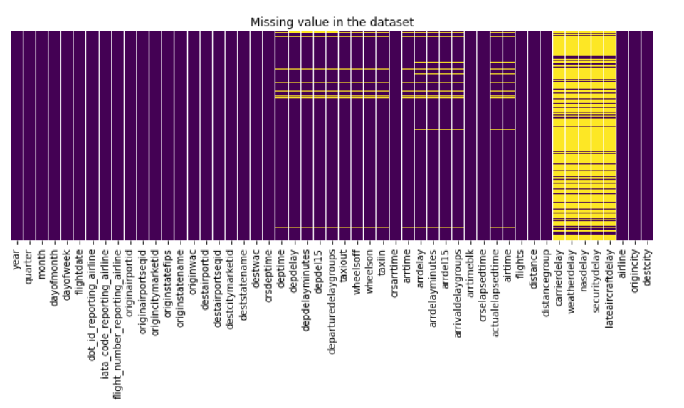
Data Cleaning
2 Datasets
Merged Both Datasets
Null Values
01
02
03
Flight Details – include departure and arrival information
Airline Code Description
Merge Airline Delay dataset and Airline Code Description
2.5% of 89009 rows were drop

Slide 7
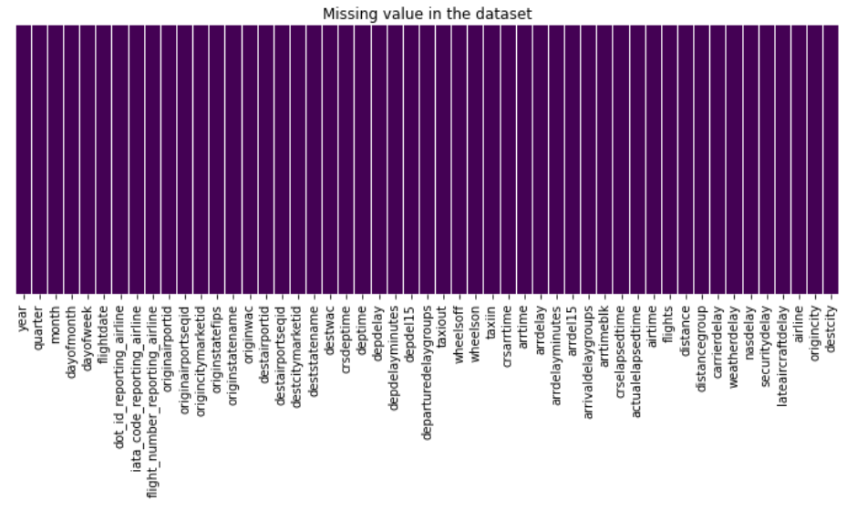
Data Cleaning
Clean Columns
Drop Columns
04
05
Replace ‘ ‘ with ‘_’
Lowercase
Columns with non-unique information were dropped.
df.shape
(86761,51)

Slide 8


Data Exploratory
Images reveal large amounts of data, so remember: use an image instead of a long text. Your audience will appreciate it

Slide 9
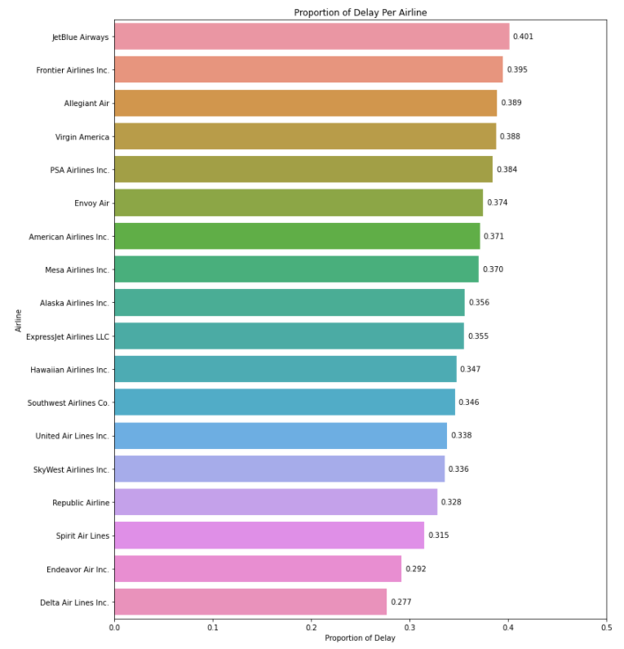
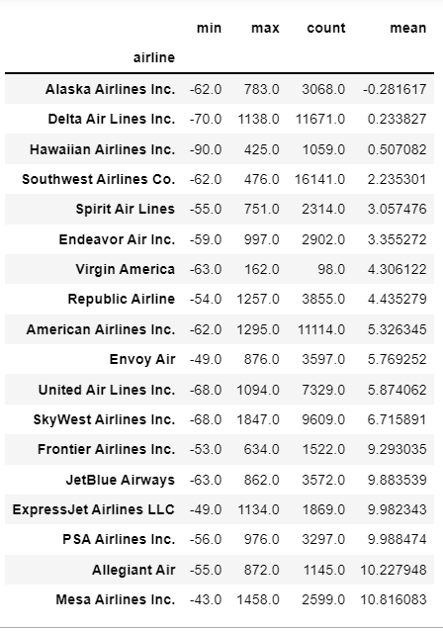

Slide 10
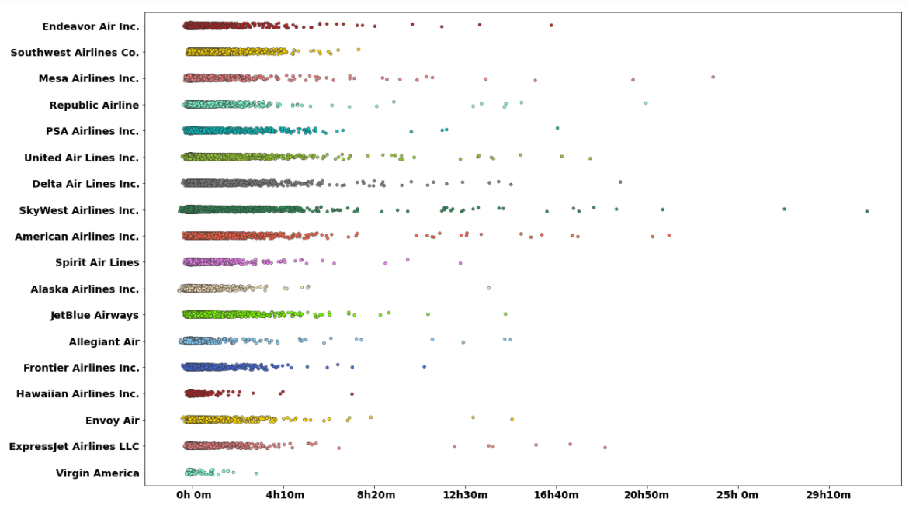

Slide 11
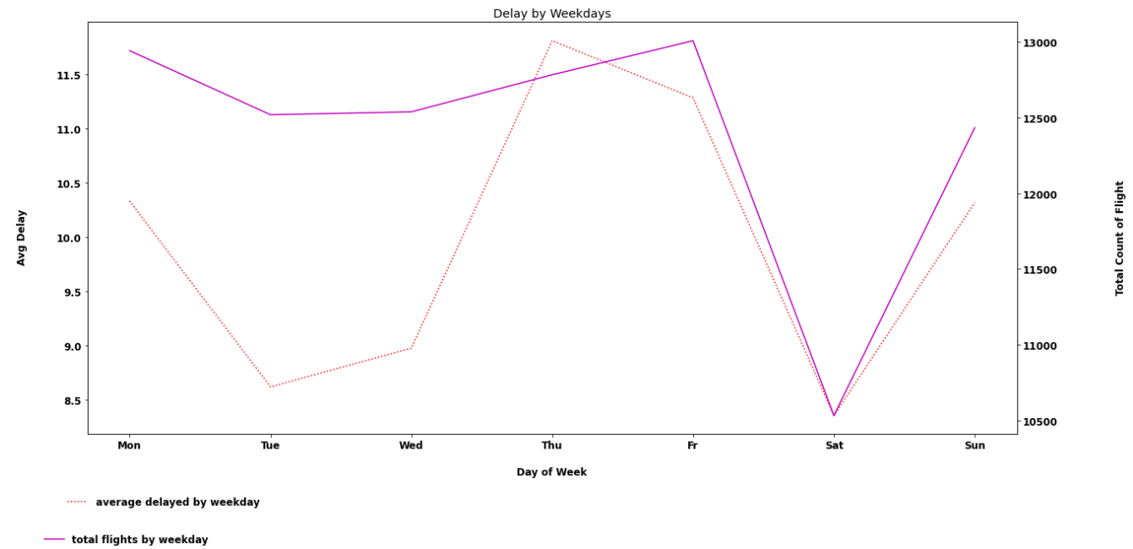

Slide 13
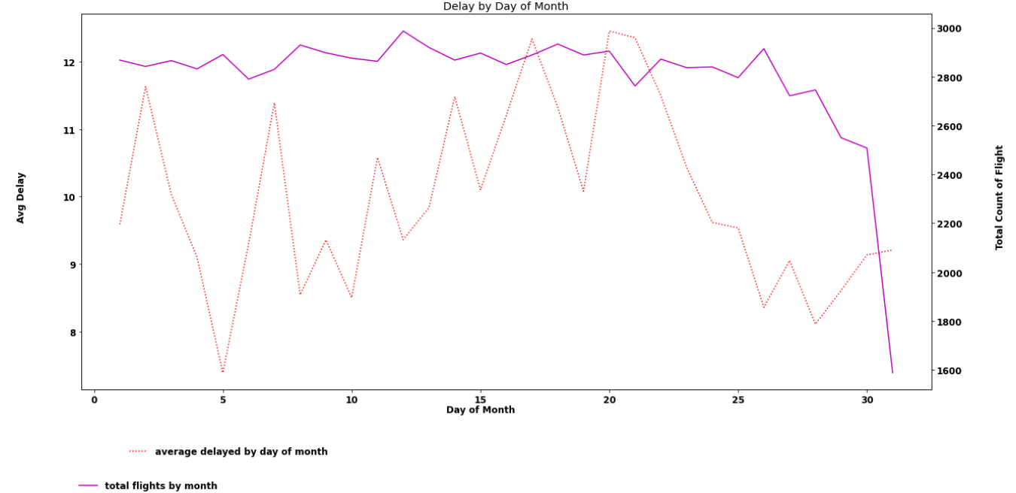

Slide 14
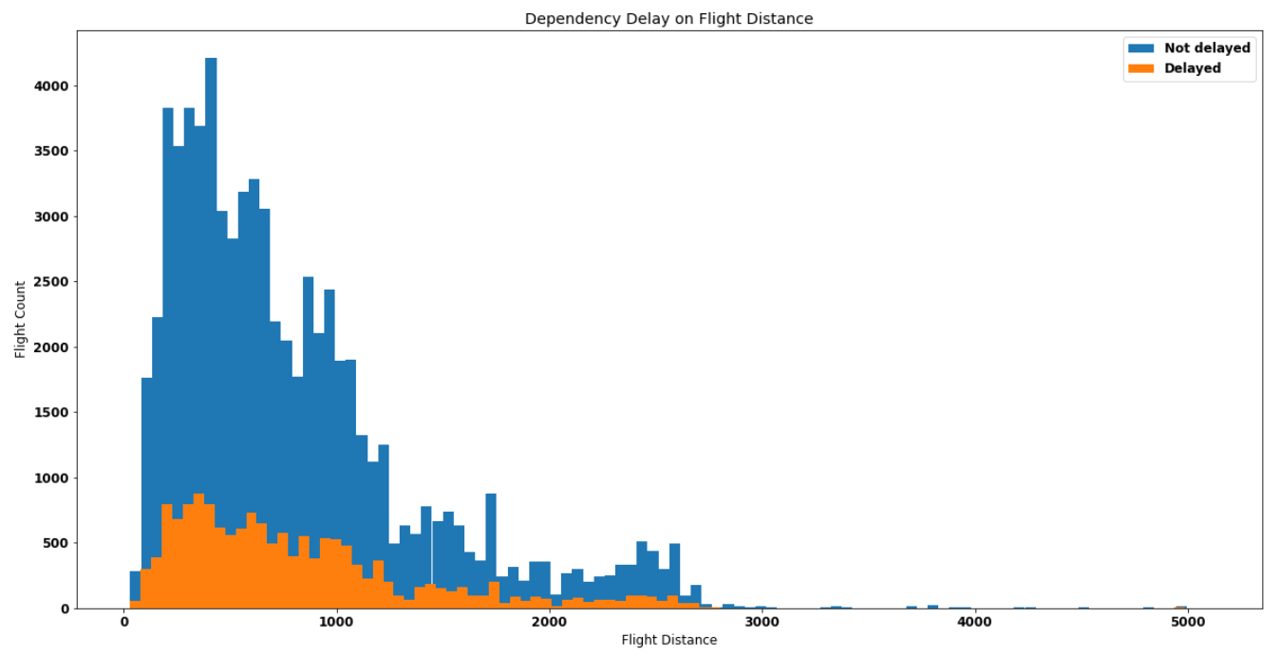

Slide 15
04.
Feature Engineering

Slide 16
Feature Engineering
One Hot Encoder
Selecting Features
Polynomial Feature
Dummify Destination City(‘object’)
Feature Selection based on domain knowledge the information available before departure
Polynomial feature on best 10 feature importance to improve model performance

Slide 17
05.
Model Performance

Slide 18
Model Performance
Model | Train Score | Test Score | Recall | ROC-AUC
Logistic Regression | 65.6% | 65% | 61% | 65.1%
Random Forest | 64.4% | 62.6% | 69% | 62.9%
First Run
Model | Train Score | Test Score | Recall | ROC-AUC
Logistic Regression | 64.5% | 63.8% | 59% | 64.2%
Random Forest | 63.8% | 62.3% | 67% | 63.1%
Second Run

Slide 19
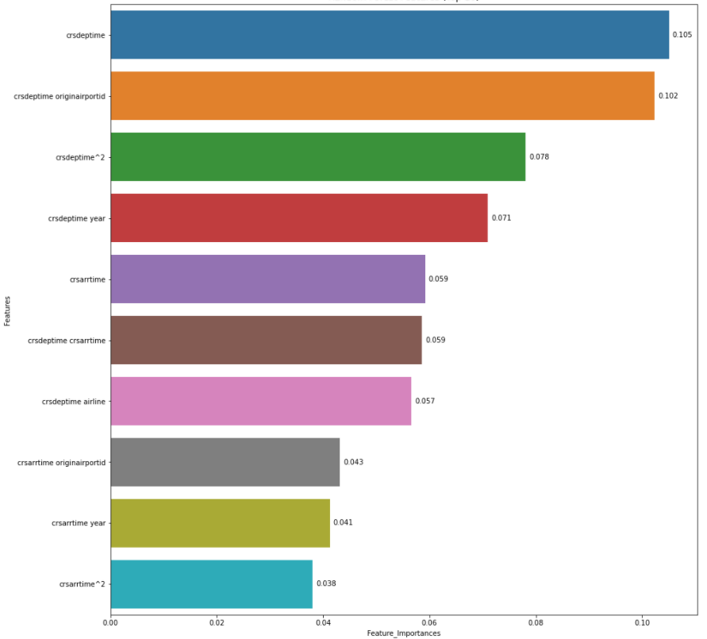
Best Features

Slide 20
Opportunity for Improvement
Run other classification model such as Gradient Boost or a much simpler one i.e Decision Tree
Project has the potential to go beyond by predicting the minutes delay.

Slide 21
THANKS
Do you have any questions?
ariffinsarhid@gmail.com

